Slide 1
William Stallings
Computer Organization and Architecture
Chapter 2
Computer Evolution and Performance

Slide 2
ENIAC - background
Electronic Numerical Integrator And Computer.
Eckert and Mauchly.
University of Pennsylvania.
Started 1943.
Finished 1946.
  Too late for war effort.
Used until 1955.

Slide 3
ENIAC - details
Decimal (not binary).
20 accumulators of 10 digits.
Programmed manually by switches.
18,000 vacuum tubes.
30 tons.
15,000 square feet.
140 kW power consumption.
5,000 additions per second.

Slide 4
von Neumann
Its Stored Program concept proposed 1946.
Main memory storing programs and data.
ALU operating on binary data.
Control unit interpreting instructions from memory and executing.
Input and output equipment operated by control unit.
Princeton Institute for Advanced Studies
  IAS
Completed 1952.

Slide 5
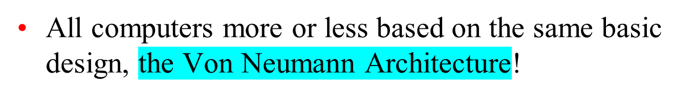
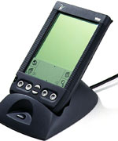
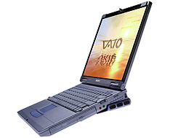
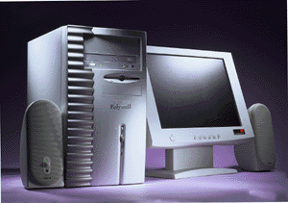
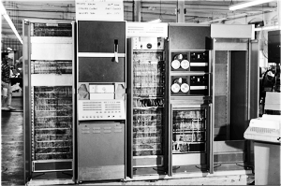
Designing Computers

Slide 6
The Von Neumann Architecture
Model for designing and building computers, based on the following three characteristics:
  The computer consists of four main sub-systems:
    Memory
    ALU (Arithmetic/Logic Unit)
    Control Unit
    Input/Output System (I/O)
  Program is stored in memory during execution.
  Program instructions are executed sequentially.

Slide 7
The Von Neumann Architecture
Bus
Memory
Processor (CPU)
Input-Output
Control Unit
ALU
Communicate with
"outside world", e.g.
Screen
Keyboard
Storage devices
...
Store data and program
Execute program
Do arithmetic/logic operations
requested by program

Slide 8
Von Neuman Machine
A main memory, which stored both of data and instruction.
An arithmetic and logic unit (ALU) capable of operating on binary data.
A control unit, interprets the instructions in memory and causes them to be executed.
Input and Output equipment operated by the control unit

Slide 9
IAS - details
Institute for advanced Study.
1000 x 40 bit words.
  Binary number.
  2 x 20 bit instructions
Set of registers (storage in CPU).
  Memory Buffer Register.
  Memory Address Register.
  Instruction Register.
  Instruction Buffer Register.
  Program Counter.
  Accumulator.

Slide 10
IBM
Punched-card processing equipment.
1953.
  IBM’s first stored program computer.
  Scientific calculations.
1955.
  Business applications.

Slide 11
Generations of Computer
Vacuum tube - 1946-1957
Transistor - 1958-1964
Small scale integration - 1965 on
  Up to 100 devices on a chip
Medium scale integration - to 1971
  100-3,000 devices on a chip
Large scale integration - 1971-1977
  3,000 - 100,000 devices on a chip
Very large scale integration - 1978
  100,000 - 100,000,000 devices on a chip
Ultra large scale integration
  Over 100,000,000 devices on a chip

Slide 12
Moore’s Law
Increased density of components on chip
Gordon Moore - cofounder of Intel
Number of transistors on a chip will double every year
Since 1970’s development has slowed a little
  Number of transistors doubles every 18 months
Cost of a chip has remained almost unchanged
Higher packing density means shorter electrical paths, giving higher performance
Smaller size gives increased flexibility
Reduced power and cooling requirements
Fewer interconnections increases reliability

Slide 13
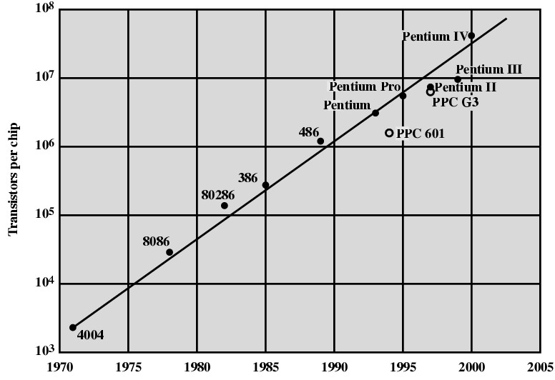
Growth in CPU Transistor Count

Slide 14
IBM 360 series
1964
Replaced (& not compatible with) 7000 series
Characteristics of First planned “family” of computers
  Similar or identical instruction sets
  Similar or identical O/S
  Increasing speed
  Increasing number of I/O ports (i.e. more terminals)
  Increased memory size
  Increased cost

Slide 15
DEC PDP-8
1964
First minicomputer (after miniskirt!)
Did not need air conditioned room
Small enough to sit on a lab bench

Slide 16
DEC - PDP-8 Bus Structure
Console
Controller
Main Memory
I/O
Module
I/O
Module
CPU
OMNIBUS

Slide 17
Semiconductor Memory
1970
Was produced by Fairchild
Size of a single core
  i.e. 1 bit of magnetic core storage
Holds 256 bits
Non-destructive read
Much faster than core
Capacity approximately doubles each year

Slide 18
Intel
1971 - 4004
  First microprocessor
  All CPU components on a single chip
  4 bit
Followed in 1972 by 8008
  8 bit = 1 byte
  Both designed for specific applications
1974 - 8080
  Intel’s first general purpose microprocessor

Slide 19
Speeding it up
Pipelining
On board cache
Branch prediction
Data flow analysis

Slide 20
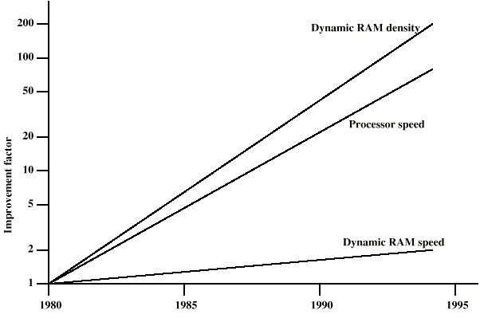
DRAM and Processor Characteristics

Slide 21
Solutions
Increase number of bits retrieved at one time
  Make DRAM “wider” rather than “deeper”
Change DRAM interface
  Cache
Reduce frequency of memory access
  More complex cache and cache on chip
Increase interconnection bandwidth
  High speed buses

Slide 22
Pentium Evolution (1)
8080
  first general purpose microprocessor
  8 bit data path
  Used in first personal computer – Altair
8086
  much more powerful
  16 bit
  instruction cache, prefetch few instructions
  8088 (8 bit external bus) used in first IBM PC
80286
  16 Mbyte memory addressable
  up from 1Mb
80386
  32 bit
  Support for multitasking
الاستعمال
الحجم
الاسم
الإصدار

Slide 23
Pentium Evolution (2)
80486
  sophisticated powerful cache and instruction pipelining
  built in maths co-processor
Pentium
  Superscalar
  Multiple instructions executed in parallel
Pentium Pro
  Increased superscalar organization
  Aggressive register renaming
  branch prediction
  data flow analysis
  speculative execution

Slide 24
Pentium Evolution (3)
Pentium II
  MMX technology
  graphics, video & audio processing
Pentium III
  Additional floating point instructions for 3D graphics
Pentium 4
  Note Arabic rather than Roman numerals
  Further floating point and multimedia enhancements
Itanium
  64 bit
  see chapter 15
See Intel web pages for detailed information on processors

Slide 25
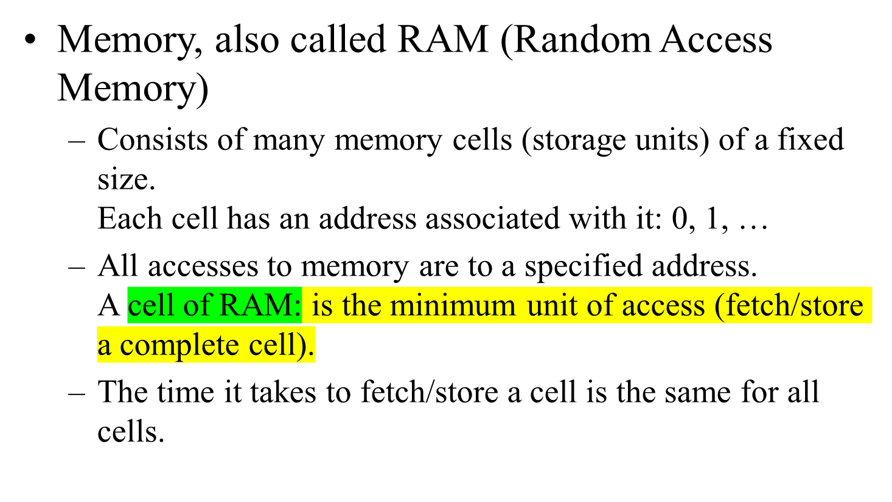
Memory Subsystem

Slide 26
When the computer is running, both
  Program
  Data (variables)
are stored in the memory.

Slide 27
RAM
Need to distinguish between
  the address of a memory cell and the content of a memory cell
Memory width (W):
  How many bits is each memory cell, typically one byte (=8 bits)
Address width (N):
  How many bits used to represent each address, determines the maximum memory size = address space
  If address width is N-bits, then address space is 2^{N} (0,1,...,2^{N}-1)
N
0000000000000001
1 bit
0
1
2
...
2^{N}
2^{N}-1
W

Slide 28
Memory Size / Speed
Typical memory in a personal computer (PC):
  64MB - 256MB
Memory sizes:
  Kilobyte (KB)= 2¹⁰ = 1,024 bytes ~ 1 thousand
  Megabyte(MB) = 2²⁰ = 1,048,576 bytes ~ 1 million
  Gigabyte (GB) = 2³⁰ = 1,073,741,824 bytes ~ 1 billion
Memory Access Time (read from/ write to memory)
  50-75 nanoseconds (1 nsec. = 0.000000001 sec.)
RAM is
  volatile (can only store when power is on)
  relatively expensive

Slide 29
Operations on Memory
Fetch (address):
  Fetch a copy of the content of memory cell with the specified address.
  Non-destructive, copies value in memory cell.
Store (address, value):
  Store the specified value into the memory cell specified by address.
  Destructive, overwrites the previous value of the memory cell.
The memory system is interfaced via:
  Memory Address Register (MAR)
  Memory Data Register (MDR)
  Fetch/Store signal

Slide 30
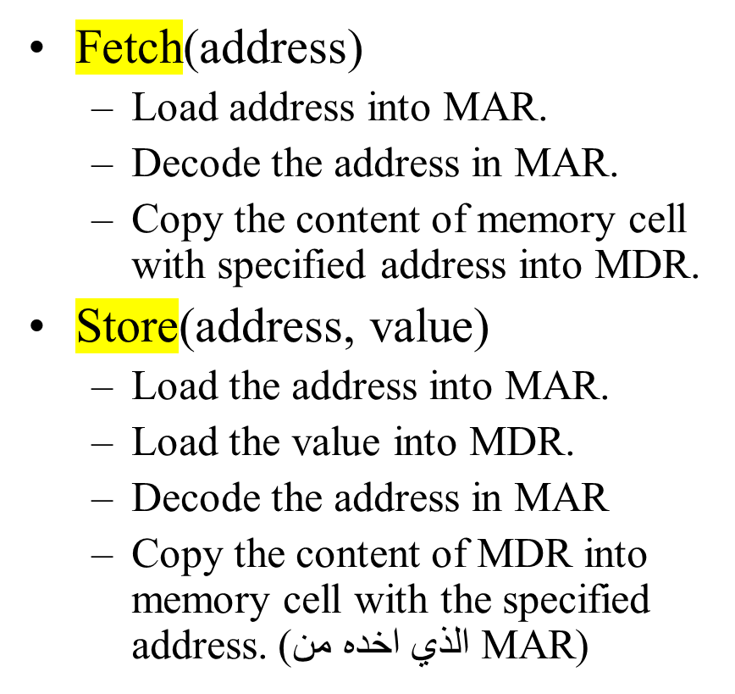
Structure of the Memory Subsystem
MAR
MDR
F/S
Memory
decoder
circuit
Fetch/Store
controller
...
Inside CPU

Slide 31
Input/Output Subsystem
Handles devices that allow the computer system to:
  Communicate and interact with the outside world
    Screen, keyboard, printer, ...
  Store information (mass-storage)
    Hard-drives, floppies, CD, tapes, …
Mass-Storage Device Access Methods:
  Direct Access Storage Devices (DASDs)
    Hard-drives, floppy-disks, CD-ROMs, ...
  Sequential Access Storage Devices (SASDs)
    Tapes (for example, used as backup devices)

Slide 32
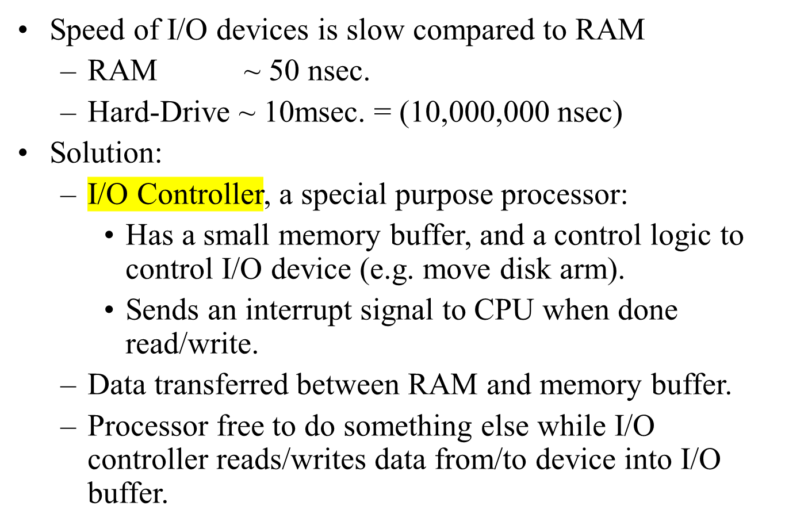
I/O Controllers

Slide 33
Structure of the I/O Subsystem
Interrupt signal (to processor)
Data from/to memory
I/O controller
I/O Buffer
Control/Logic
I/O device

Slide 34
The ALU Subsystem
The ALU (Arithmetic/Logic Unit) performs
  mathematical operations (+, -, x, /, …)
  logic operations (=, <, >, and, or, not, ...)
In today's computers integrated into the CPU
Consists of:
  Circuits to do the arithmetic/logic operations.
  Registers (fast storage units) to store intermediate computational results.
  Bus that connects the two.

Slide 35
Structure of the ALU
Registers:
  Very fast local memory cells, that store operands of operations and intermediate results.
  CCR (condition code register), a special purpose register that stores the result of <, = , > operations
ALU circuitry:
  Contains an array of circuits to do mathematical/logic operations.
Bus:
  Data path interconnecting the registers to the ALU circuitry.
R0
R1
R2
Rn
ALU circuitry
GT
EQ
LT
Notes:
CMPUT101 Introduction to Computing - Spring 2001
Chapter 5 The Von Neumann Architecture

Slide 36
The Control Unit
Program is stored in memory
  as machine language instructions, in binary
The task of the control unit is to execute programs by repeatedly:
  Fetch from memory the next instruction to be executed.
  Decode it, that is, determine what is to be done.
  Execute it by issuing the appropriate signals to the ALU, memory, and I/O subsystems.
  Continues until the HALT instruction

Slide 37
Instruction Set Design
Two different approaches:
  Reduced Instruction Set Computers (RISC)
    Instruction set as small and simple as possible.
    Minimizes amount of circuitry --> faster computers
  Complex Instruction Set Computers (CISC)
    More instructions, very complex
    Each instruction can do more work, but require more circuitry.

Slide 38
Typical Machine Instructions
Notation:
  We use X, Y, Z to denote RAM cells
  Assume only one register R (for simplicity)
  Use English-like descriptions (should be binary)
Data Transfer Instructions
  LOAD X Load content of memory location X to R
  STORE X Load content of R to memory location X
  MOVE X, Y Copy content of memory location X to loc. Y

Slide 39
Example
Pseudo-code: Set A to B + C
Assuming variable:
  A stored in memory cell 100, B stored in memory cell 150, C stored in memory cell 151
Machine language (really in binary)
  LOAD 150
  ADD 151
  STORE 100
  or
  (ADD 150, 151, 100)
sisc
risc

Slide 40
Structure of the Control Unit
PC (Program Counter):
  stores the address of next instruction to fetch
IR (Instruction Register):
  stores the instruction fetched from memory
Instruction Decoder:
  Decodes instruction and activates necessary circuitry
PC
IR
+1
Instruction
Decoder

Slide 41
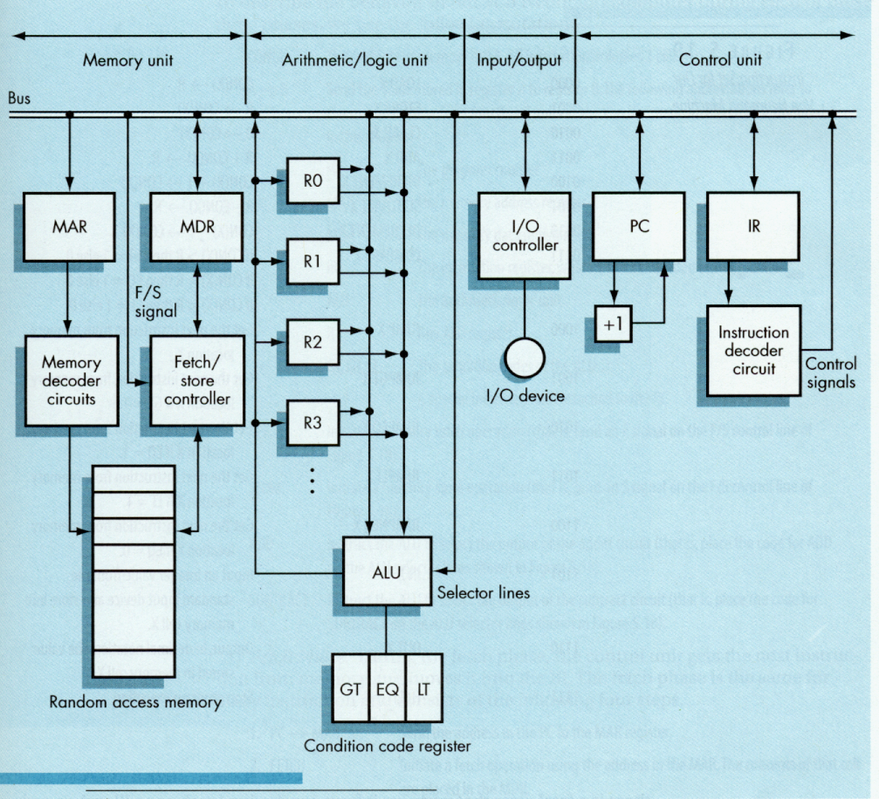
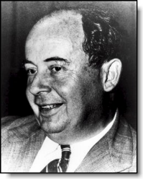
von Neumann
Architecture
CMPUT101 Introduction to Computing
(c) Yngvi Bjornsson

Slide 42
How does this all work together?
Program Execution:
  PC is set to the address “PC counter” where the first program instruction is stored in memory.
  Repeat until HALT instruction or fatal error
    Fetch instruction
    Decode instruction
    Execute instruction
  End of loop

Slide 43
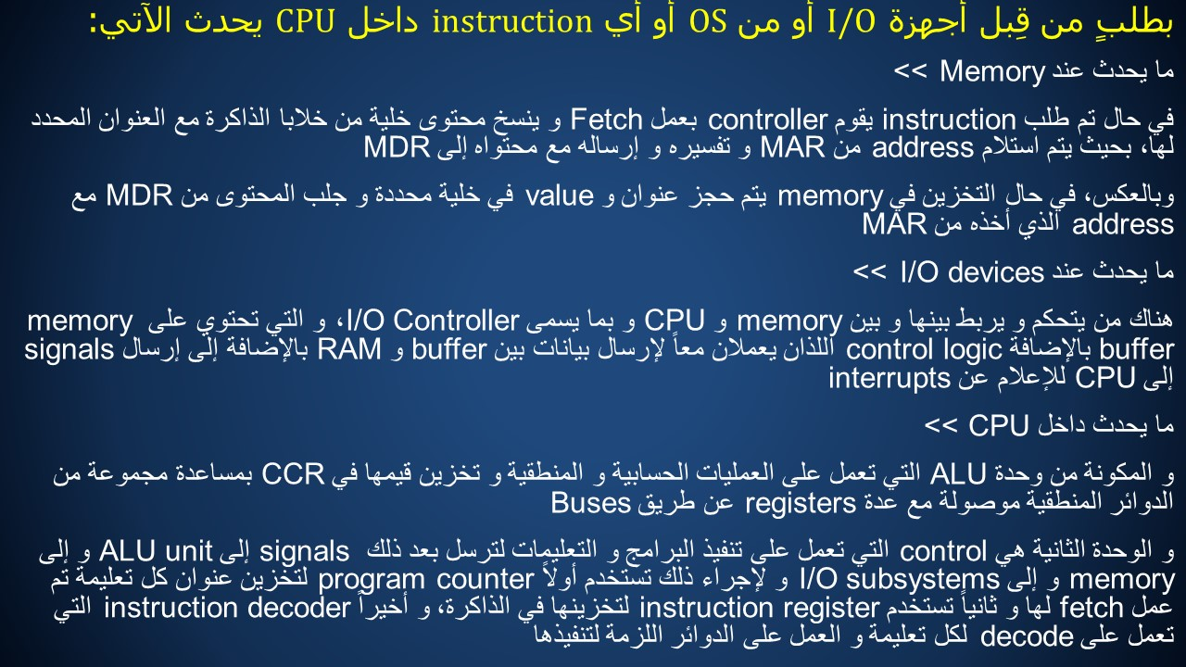
CMPUT101 Introduction to Computing
(c) Yngvi Bjornsson

